Slide 1

UNIVERSITY INSTITUTE OF ENGINEERING
COMPUTER SCIENCE ENGINEERING
ARTIFICIAL INTELLIGENCE
(21CSH-611/621)
INTRODUCTION
DISCOVER . LEARN . EMPOWER

Slide 2
Search
Search permeates all of AI
What choices are we searching through?
Problem solving Action combinations (move 1, then move 3, then move 2...)
Natural language Ways to map words to parts of speech
Computer vision Ways to map features to object model
Machine learning Possible concepts that fit examples seen so far
Motion planning Sequence of moves to reach goal destination
An intelligent agent is trying to find a set or sequence of actions to achieve a goal
This is a goal-based agent

Slide 3
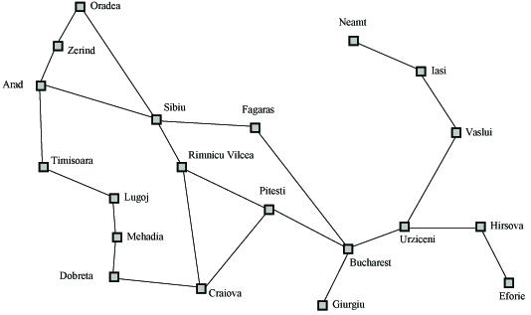
Search Example
Formulate goal: Be in Bucharest.
Formulate problem: states are cities, operators drive between pairs of cities
Find solution: Find a sequence of cities (e.g., Arad, Sibiu, Fagaras, Bucharest) that leads from the current state to a state meeting the goal condition

Slide 4
Search Space Definitions
State
A description of a possible state of the world
Includes all features of the world that are pertinent to the problem
Initial state
Description of all pertinent aspects of the state in which the agent starts the search
Goal test
Conditions the agent is trying to meet (e.g., have $1M)
Goal state
Any state which meets the goal condition
Thursday, have $1M, live in NYC
Friday, have $1M, live in Valparaiso
Action
Function that maps (transitions) from one state to another

Slide 5
Search Space Definitions
Problem formulation
Describe a general problem as a search problem
Solution
Sequence of actions that transitions the world from the initial state to a goal state
Solution cost (additive)
Sum of the cost of operators
Alternative: sum of distances, number of steps, etc.
Search
Process of looking for a solution
Search algorithm takes problem as input and returns solution
We are searching through a space of possible states
Execution
Process of executing sequence of actions (solution)

Slide 6
Problem Formulation
A search problem is defined by the
Initial state (e.g., Arad)
Operators (e.g., Arad -> Zerind, Arad -> Sibiu, etc.)
Goal test (e.g., at Bucharest)
Solution cost (e.g., path cost)

Slide 7
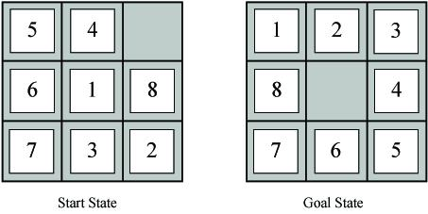
Example Problems – Eight Puzzle
States: tile locations
Initial state: one specific tile configuration
Operators: move blank tile left, right, up, or down
Goal: tiles are numbered from one to eight around the square
Path cost: cost of 1 per move (solution cost same as number of most or path length)
Eight puzzle applet

Slide 8
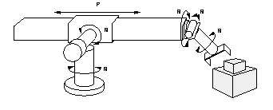
Example Problems – Robot Assembly
States: real-valued coordinates of
robot joint angles
parts of the object to be assembled
Operators: rotation of joint angles
Goal test: complete assembly
Path cost: time to complete assembly

Slide 9

Example Problems – Towers of Hanoi
States: combinations of poles and disks
Operators: move disk x from pole y to pole z subject to constraints
cannot move disk on top of smaller disk
cannot move disk if other disks on top
Goal test: disks from largest (at bottom) to smallest on goal pole
Path cost: 1 per move
Towers of Hanoi applet
Possible move (optimal)= ( 2^{n}-1)
Where n is number of disks

Slide 10
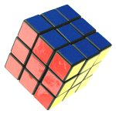
Example Problems – Rubik’s Cube
States: list of colors for each cell on each face
Initial state: one specific cube configuration
Operators: rotate row x or column y on face z direction a
Goal: configuration has only one color on each face
Path cost: 1 per move
Rubik’s cube applet

Slide 11
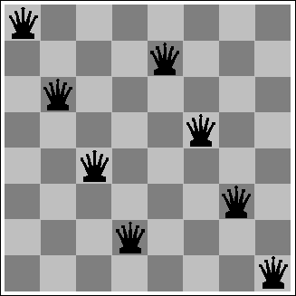
Example Problems – Eight Queens
States: locations of 8 queens on chess board
Initial state: one specific queens configuration
Operators: move queen x to row y and column z
Goal: no queen can attack another (cannot be in same row, column, or diagonal)
Path cost: 0 per move
Eight queens applet

Slide 12
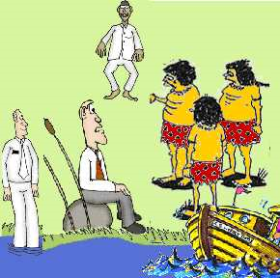
Example Problems – Missionaries and Cannibals
States: number of missionaries, cannibals, and boat on near river bank
Initial state: all objects on near river bank
Operators: move boat with x missionaries and y cannibals to other side of river
no more cannibals than missionaries on either river bank or in boat
boat holds at most m occupants
Goal: all objects on far river bank
Path cost: 1 per river crossing
Missionaries and cannibals applet

Slide 13

Example Problems –Water Jug
States: Contents of 4-gallon jug and 3-gallon jug
Initial state: (0,0)
Operators:
fill jug x from faucet
pour contents of jug x in jug y until y full
dump contents of jug x down drain
Goal: (2,n)
Path cost: 1 per fill
Saving the world, Part I
Saving the world, Part II

Slide 14
Sample Search Problems
Graph coloring
Protein folding
Game playing
Airline travel
Proving algebraic equalities
Robot motion planning

Slide 15
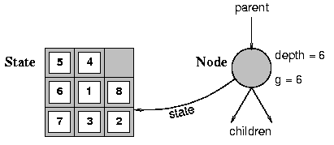
Visualize Search Space as a Tree
States are nodes
Actions are edges
Initial state is root
Solution is path from root to goal node
Edges sometimes have associated costs
States resulting from operator are children

Slide 16
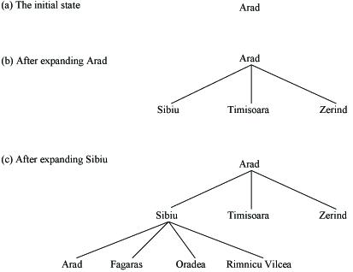
Search Problem Example (as a tree)

Slide 17
Search Function – Uninformed Searches
Open = initial state // open list is all generated states
// that have not been “expanded”
While open not empty // one iteration of search algorithm
state = First(open) // current state is first state in open
Pop(open) // remove new current state from open
if Goal(state) // test current state for goal condition
return “succeed” // search is complete
// else expand the current state by
// generating children and
// reorder open list per search strategy
else open = QueueFunction(open, Expand(state))
Return “fail”

Slide 18
Search Strategies
Search strategies differ only in Queuing Function
Features by which to compare search strategies
Completeness (always find solution)
Cost of search (time and space)
Cost of solution, optimal solution
Make use of knowledge of the domain
“uninformed search” vs. “informed search”

Slide 19
Breadth-First Search
Generate children of a state, QueueingFn adds the children to the end of the open list
Level-by-level search
Order in which children are inserted on open list is arbitrary
In tree, assume children are considered left-to-right unless specified differently
Number of children is “branching factor” b

Slide 20
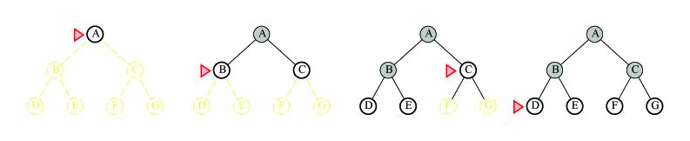
BFS Examples
b = 2
Example trees
Search algorithms applet

Slide 21
Analysis
See what happens with b=10
expand 10,000 nodes/second
1,000 bytes/node
Depth | Nodes | Time | Memory
2 | 1110 | .11 seconds | 1 megabyte
4 | 111,100 | 11 seconds | 106 megabytes
6 | 10⁷ | 19 minutes | 10 gigabytes
8 | 10⁹ | 31 hours | 1 terabyte
10 | 10¹¹ | 129 days | 101 terabytes
12 | 10¹³ | 35 years | 10 petabytes
15 | 10¹⁵ | 3,523 years | 1 exabyte

Slide 22
Depth-First Search
Queueing Fn adds the children to the front of the open list
BFS emulates FIFO queue
DFS emulates LIFO stack
Net effect
Follow leftmost path to bottom, then backtrack
Expand deepest node first

Slide 23
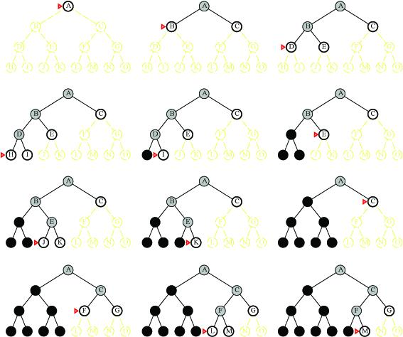
DFS Examples
Example trees

Slide 24
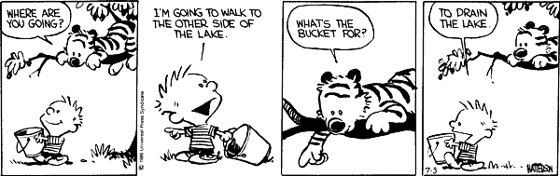
Comparison of Search Techniques
 | DFS | BFS
Complete | N | Y
Optimal | N | N
Heuristic | N | N
Time | b^{m} | b^{d+1}
Space | bm | b^{d+1}

Slide 25
Avoiding Repeated States
Can we do it?
Do not return to parent or grandparent state
In 8 puzzle, do not move up right after down
Do not create solution paths with cycles
Do not generate repeated states (need to store and check potentially large number of states)

Slide 26
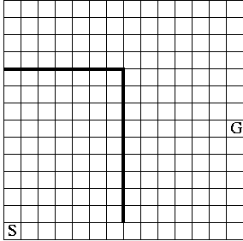
Maze Example
States are cells in a maze
Move N, E, S, or W
What would BFS do (expand E, then N, W, S)?
What would DFS do?
What if order changed to N, E, S, W and loops are prevented?

Slide 27
THANK YOU

